Slide 1
jQuery Mobile 1.2.0 Touch Optimized Web Framework for Smartphones & Tablets

Slide 2
Index
Overview
Introduction
Pre-requisites
Why JQM
Supported Platforms
Unified UI across all Platforms
Progressive Enhancement
Responsive Design
Build Once, Run Anywhere Myth
Themable Styling
Accessible
Components
JQM Page
Toolbars
Inputs, Buttons
Select, Radio, Checkbox
Slider, Switch
Native Form Elements
List
Grid
Collapsible
Ajax Driven Navigation
Transitions
Dialog, Popup
API
Configuring Defaults
Events
Methods & Utilities
Data Attributes
Theme Framework

Slide 3
Overview
Introduction
Pre-requisites
Why JQM
Supported Platforms
Unified UI across all Platforms
Progressive Enhancement
Responsive Design
Build Once, Run Anywhere Myth
Themable Styling
Accessible

Slide 4
Introduction
A Touch-Optimized UI Framework built with jQuery & HTML5.
Focused on a feature-rich but lightweight codebase.
Accessibility features such as WAI-ARIA are tightly integrated.

Slide 5
Introduction (Contd…)
The framework includes -
An Ajax navigation system that brings animated page transitions.
A core set of UI widgets: pages, dialogs, toolbars, listviews, buttons with icons, form elements, accordions, collapsibles, and more.
Latest Stable Version : 1.2.0
Legacy Versions : 1.1.1 – 1.0.1
Date : 07-Jan-2013

Slide 6
Pre-requisites
HTML 5
CSS 3
jQuery 1.7.0 to 1.8.2

Slide 7
Why jQuery Mobile
JQM is new, simple to use, UI framework for building cross-platform Mobile Web applications.
Optimized to run on every phone, tablets, desktop & on e-reader devices.
Creates unified user-experience across platforms.

Slide 8
Supported Platforms
Uses 3-level graded platform support system
A – Full
B – Full minus Ajax
C – Basic HTML
Phones / Tablets | Desktop Browsers | E-Readers
Android 1.6+ | Chrome 11+ | Kindle
BlackBerry 5+ | Firefox 3.6+ | Nook
iOS 3+ | IE 7+
Windows Phone 7 | Safari
WebOS 1.4+
Symbian (Nokia 70)

Slide 9
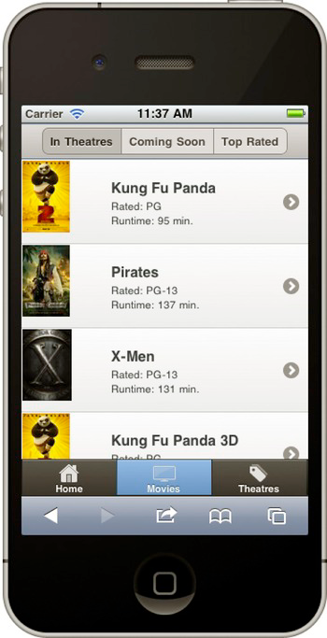
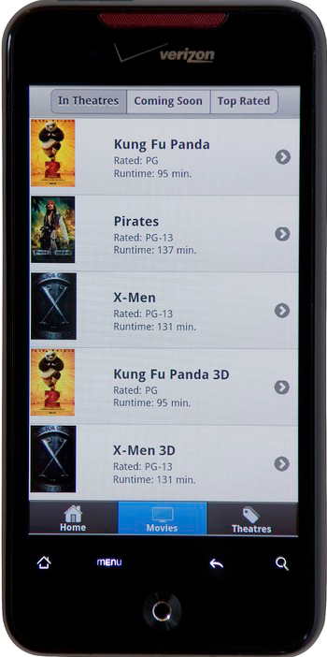
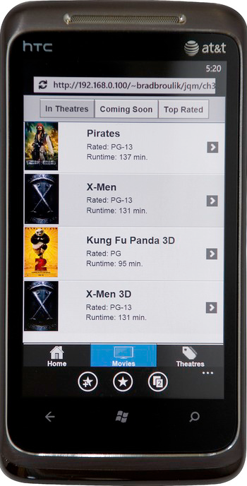
Unified UI across all Platforms

Slide 10
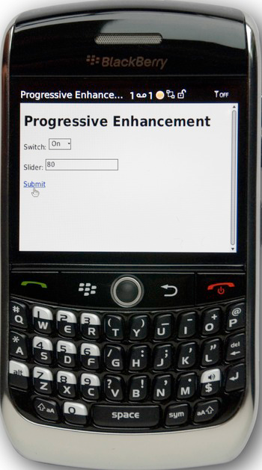
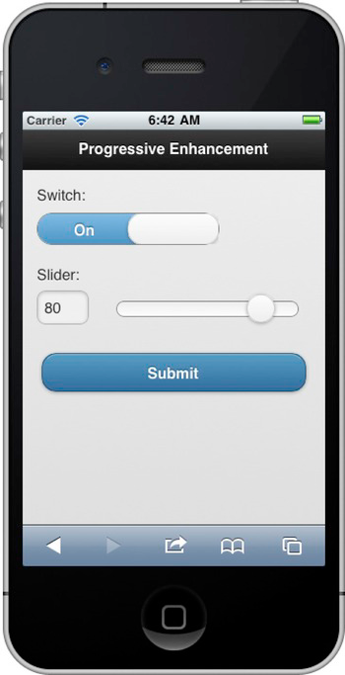
Progressive Enhancement

Slide 11
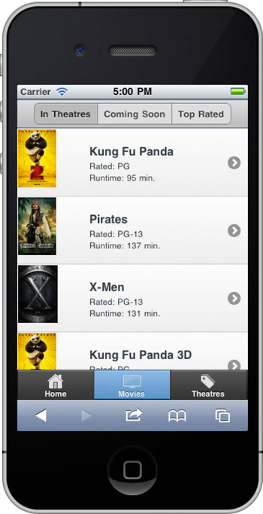
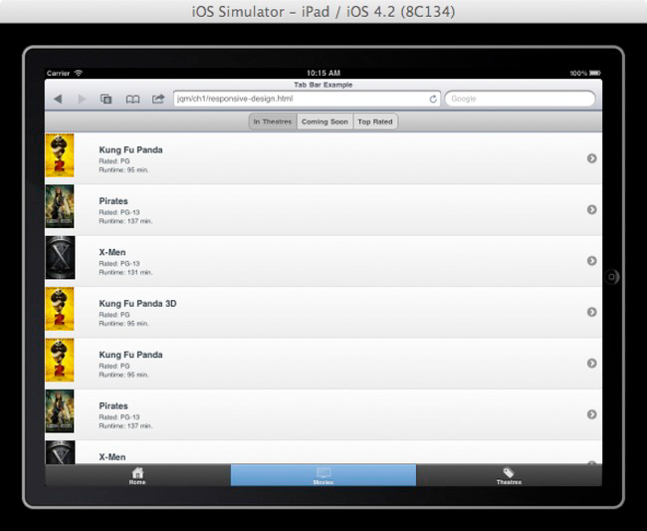
Responsive Design

Slide 12
Build Once, Run Anywhere Myth
Is it possible to build a single application that is universally available for all consumers (phone, tablet, desktop) ?
Yes, it is possible.
The web provides universal distribution.
jQuery mobile provides cross-browser support.

Slide 13
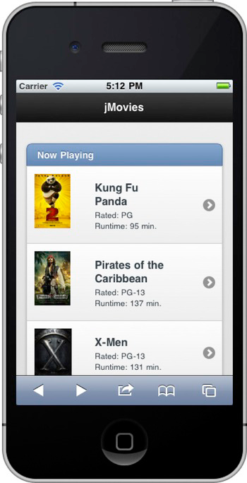
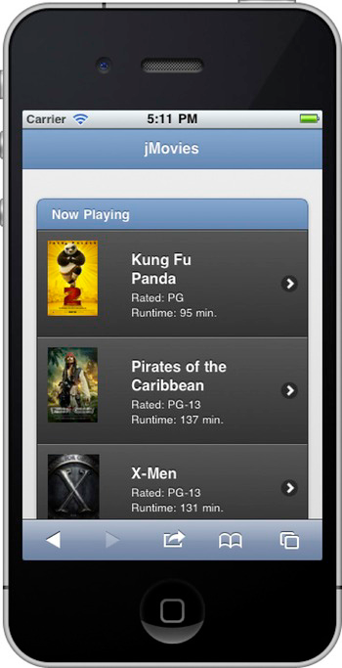
Themable Styling
Default 5 themable designs.

Slide 14

Accessible
jQuery Mobile (JQM) apps are 508 complaint by default, a characteristic this is valuable to anyone.

Slide 15
Components
JQM Page
Toolbars
Inputs, Buttons
Select, Radio, Checkbox
Slider, Switch
Native Form Elements
List
Grid
Collapsible
Ajax Driven Navigation
Transitions
Dialog, Popup

Slide 16
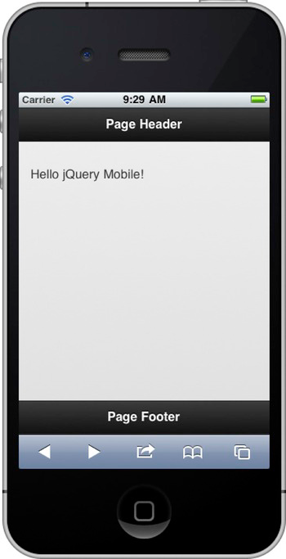
JQM Page Template
Content should be marked up semantically, since we are using HTML5 we have access to all the new tags header, footer, section, nav etc.
JQM will work with any markup, but it needs us to indicate the roles of the content areas. JQM uses custom data- attributes: data-role.

Slide 17
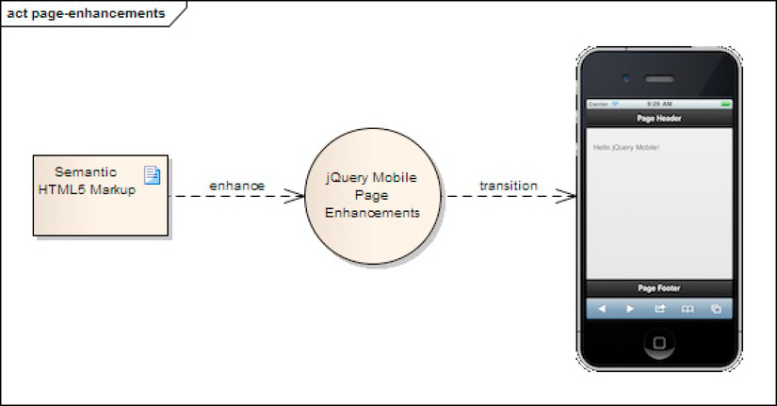
JQM Page Enhancement

Slide 18
Multi-page Template
Embed multiple pages into single HTML document.
Prefect multiple pages and achieve quicker response times.

Slide 19
Header Bar
Header Bar displays the title of the current screen.
Add buttons or add controls that mange the items on the page.
Header Bar is optional component.
Header is defined with data attribute data-role=“header”.

Slide 20
Header Positioning
Default
Fixed
Responsive

Slide 21
Header Buttons
A button with only text.
A button with only icon.
A button with text and icon.
<a href=“#”>Done</a>
<a href=“#” data-icon=“plus” data-iconpos=“notext”></a>
<a href=“#” data-icon=“check”>Done</a>

Slide 22
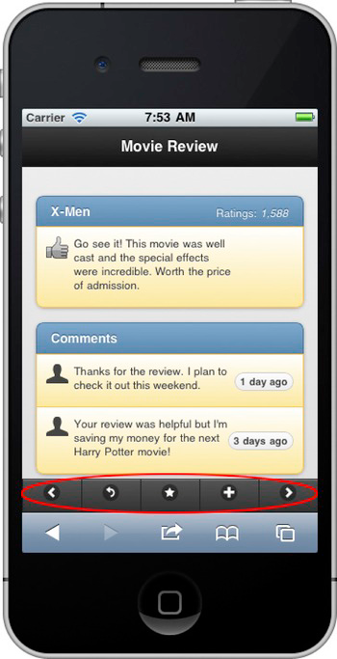
Toolbars
Toolbars helps us to manage the content of the screen.
Icon only toolbars are most common, their primary advantage is they consume less screen real estate when compared to a textual alternative.
<div data-role=“navbar”>
<ul>
<li><a href=“#” data-icon=“star”></a></li>
</ul>
</div>

Slide 23
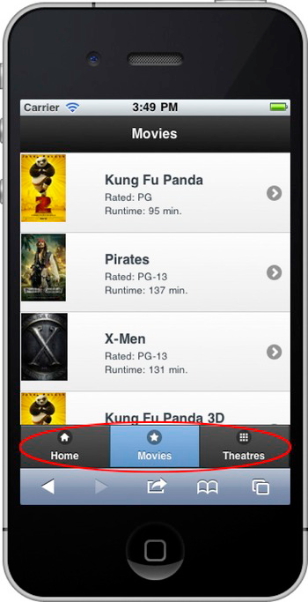
Tab Bars
A tab bar gives the user the ability to switch between different view in the application.
<div data-role=“footer”>
<div data-role=“navbar”>
<ul>
<li><a href=“#” data-icon=“home”>Home</a></li>
<li><a href=“#” data-icon=“star” class=“ui-btn-active”>Movies</a></li>
<li><a href=“#” data-icon=“grid”>Theaters</a></li>
</ul>
</div>
</div>

Slide 24
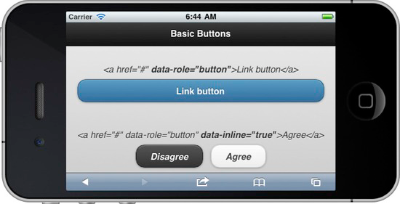
Buttons
Most commonly used control.

Slide 25
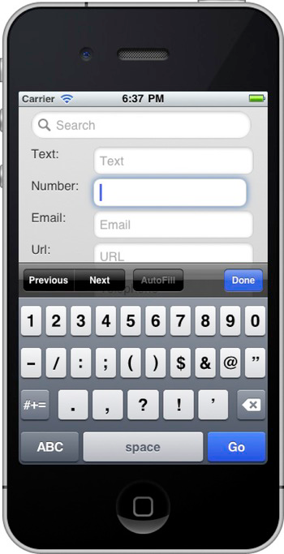
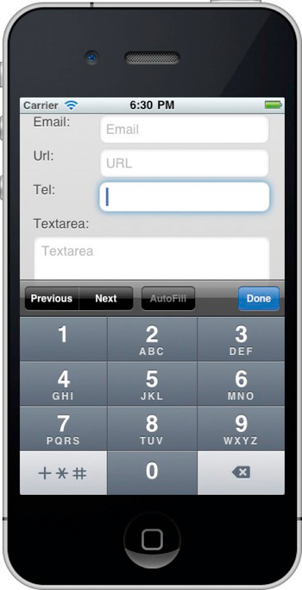
Input types

Slide 26
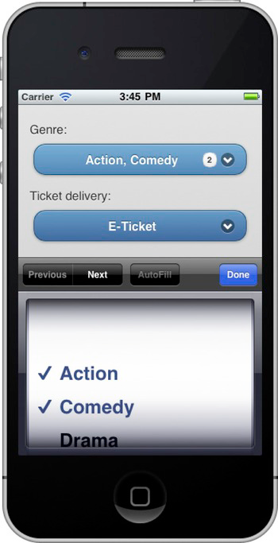
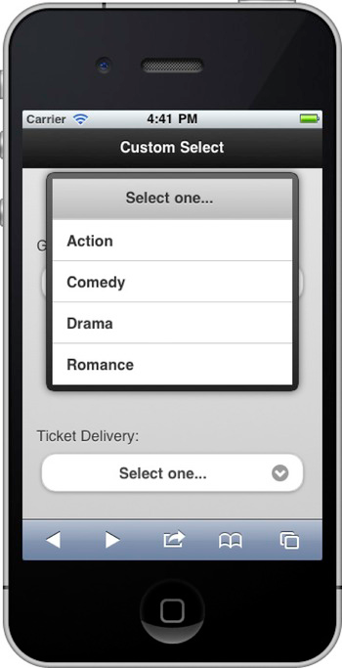
Select Menus

Slide 27
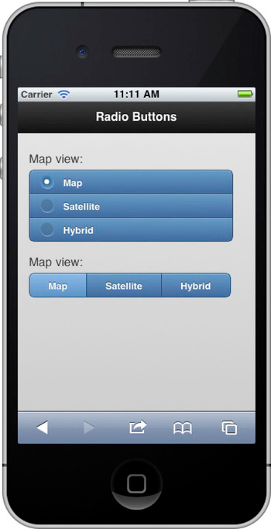
Radio Buttons
Radio buttons limits the user selection to only single item.
User can tap anywhere on the radio button to make the selection, and JQM will automatically update the underlying control.
data-role = “controlgroup”, elegantly groups the buttons together with radio buttons. data-type=“horizontal” overrides the default positioning –vertical – and displays the button horizontally.

Slide 28
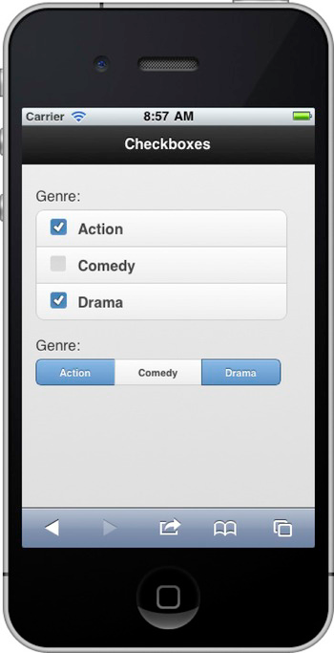
Checkboxes
Checkboxes are common form control for allowing users to select multiple values from a listing of many choices.
data-role = “controlgroup”, elegantly groups the buttons together with radio buttons. data-type=“horizontal” overrides the default positioning –vertical – and displays the button horizontally.

Slide 29
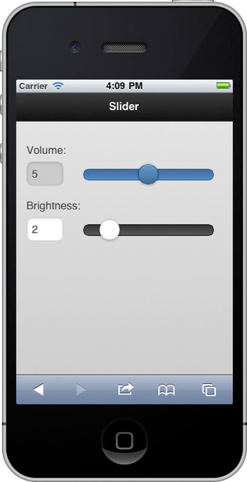
Slider
Slider is a common form control that allows user to select a value between a minimum and maximum range.
For e.g. we can adjust volume and brightness with a slider to adjust the range between a low and high setting.
The user may adjust the value by either sliding the control or by entering a value in the slider’s corresponding text field.

Slide 30
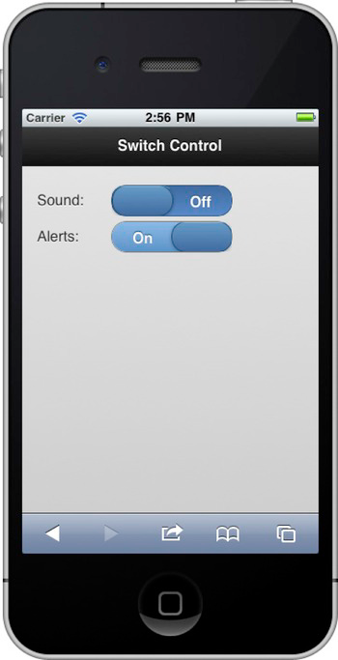
Switch Control
Switch control is commonly used to manage Boolean on/off flags.
For e.g. often preferred to manipulate application settings.
To flip the switch user can either tap the control or slide the switch.
To create a switch control, add a select element with data-role=“slider” and two options to manage “on/off” states.

Slide 31
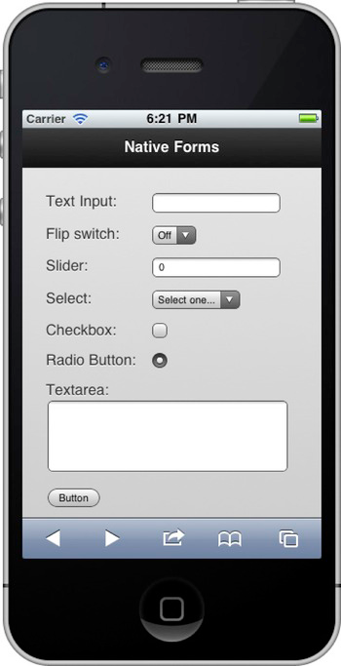
Native Form Elements
JQM automatically enhances all form elements defined on your page. However, if you want to fall back to native controls, this can be configured globally or at field level.
<label for="name">Text Input</label>
<input type="text" name="name" id="name" value="" data-role="none" />
// Globally configure native elements by selector
$(document).bind('mobileinit',function(){
$.mobile.page.prototype.options.keepNative = "input, select";
});

Slide 32
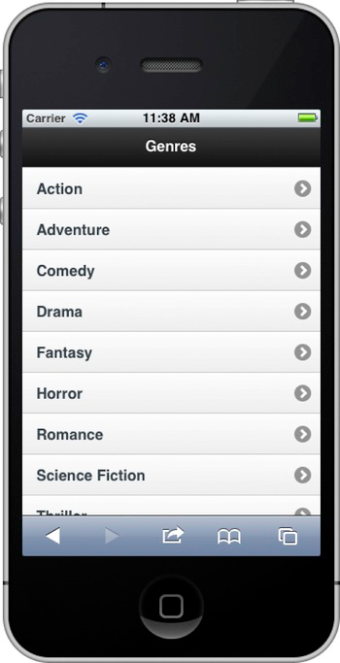
List View
List are a popular user interface component, because they make the browsing experience very simple and efficient.
JQM automatically enhance any native HTML list (ul or ol) into a mobile optimized view when we add the data-role=“list” attribute to our list item.
By default, list will be style with “c” swatch color

Slide 33
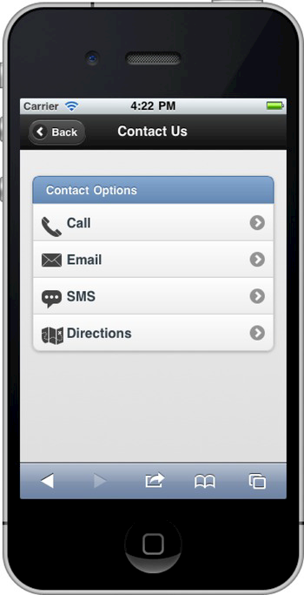
Inset Lists
An inset list will automatically wrapped inside a block with rounded corners and has margin set for additional spacing.
To create an inset list add the data-inset=“true” attribute to the list element.

Slide 34
List Divider
A list divider can be used as a heading for a group of list items.
To create a list divider, add the data-role=“list-divider” attribute to any list item.
By default, list divider will be styled with “b” swatch color.

Slide 35
List with Thumbnails and Icons
You can add thumbnails to the left of your list item by adding an image inside a list item as the first child element.
The framework will scale image to 80px square.
You can use a small icon instead of thumbnails. To use standard 16 * 16 pixel icons in list item, add the class ui-li-icon to the image element.

Slide 36
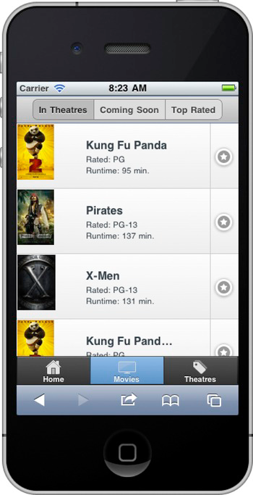
Split Button List
Split Button list provide primary and secondary button to choose from.
To create a split button list, add a secondary link inside the list item and the framework will add a vertical line dividing the primary and secondary buttons.
To set the icons for all secondary buttons, add data-split-icon attribute to the list element.

Slide 37
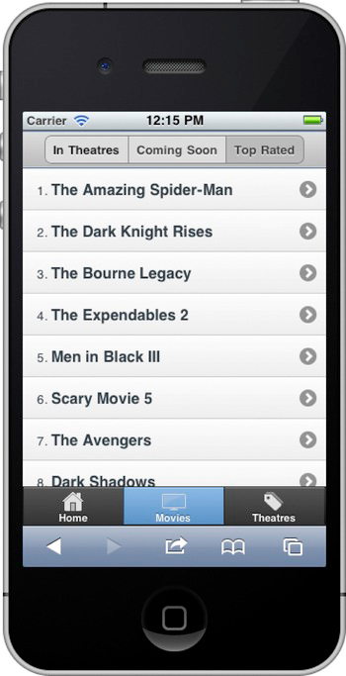
Numbered List
Numbered list is created when using an ordered list <ol>.
By default, the framework will add the numerical index to the left of each list item.
For eg. Top rated movies, is an ideal candidate for a numbered list because the sequence quickly associates which movies are rated highest.

Slide 38
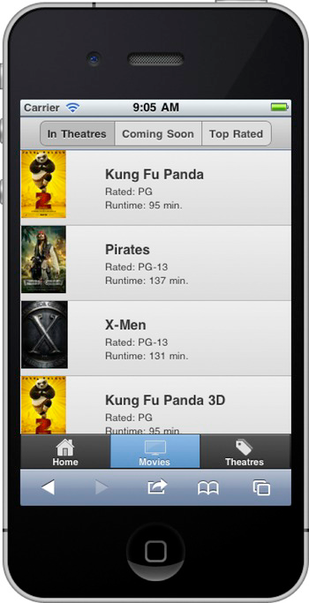
Read-only List
List can also display read-only view of data.
To create a read-only list simply remove the anchor tag.

Slide 39
List Badges (Count Bubbles)
A list badge or count bubble is a highlighted oval that typically indicates the number of new items that are available for viewing.
For e.g. badges are used to indicate when a comment was added about a movie review.
Badge element should have ui-li-count class.

Slide 40
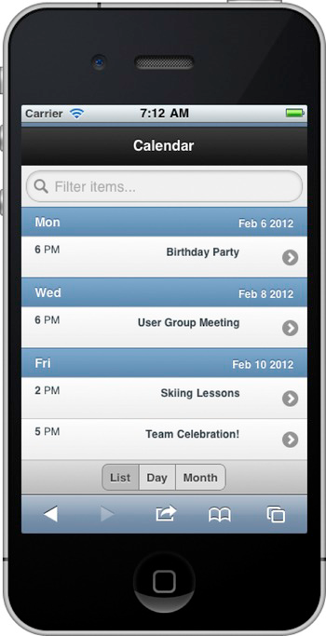
List Filtering with Search Bar
JQM has a convenient client-side search feature for filtering lists.
To create a search bar add the data-filter=“true” attribute to the list.

Slide 41
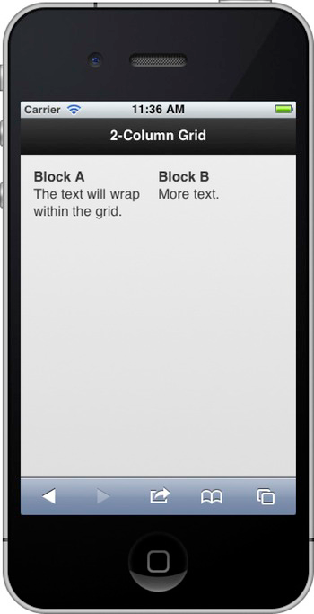
Grid Layouts
JQM grids are configurable to support layouts in the range of two to five columns.
The grid is flexible and consume entire width of you display.
<div class="<grid-css-attribute>">
<div class="<block-css-attribute>">Block A</div>
<div class="<block-css-attribute>">Block B</div>
</div>

Slide 42
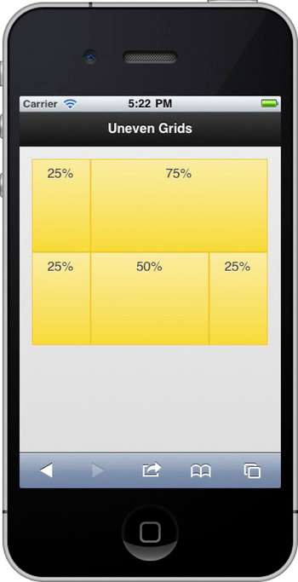
Uneven Grids
JQM grids provides evenly spaced columns.
You can modify the default width to 25/75% grid by setting the custom width of each block using CSS.

Slide 43
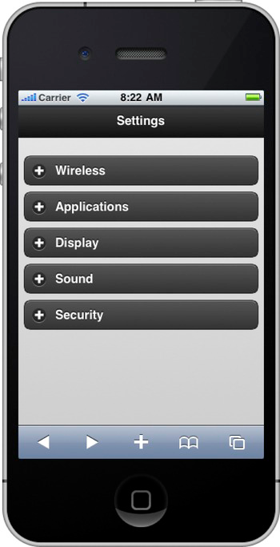
Collapsible Content
JQM provide Collapsible content which can be hidden or shown with a click or touch.
To create a collapsible content, create a container and add data-role=“collapsible” attribute.

Slide 44
Collapsible Set
Collapsible sets are similar to collapsible block except their collapsible sections are visually grouped together and only one section may be expanded at a time.
To create a collapsible set, create a container and add data-role=“collapsible-set” attribute.

Slide 45
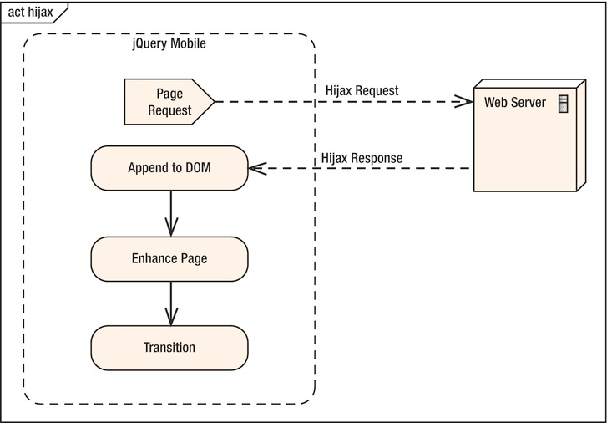
Ajax-Driven Navigation

Slide 46
Transitions
Provides 6 CSS based transitions, between pages.
Default is “slide” effect to all transitions.
<a href=“contact.html” data-transition=“slideup”>Contact</a>

Slide 47
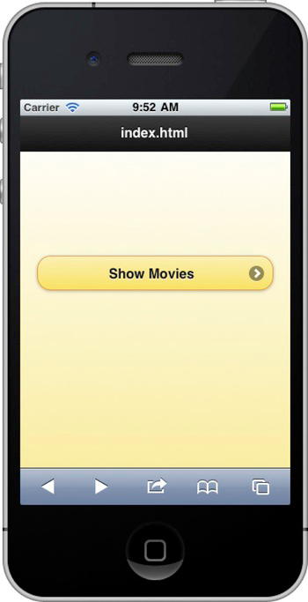
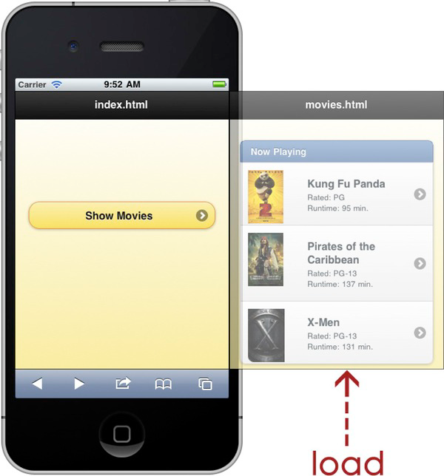

Slide 48
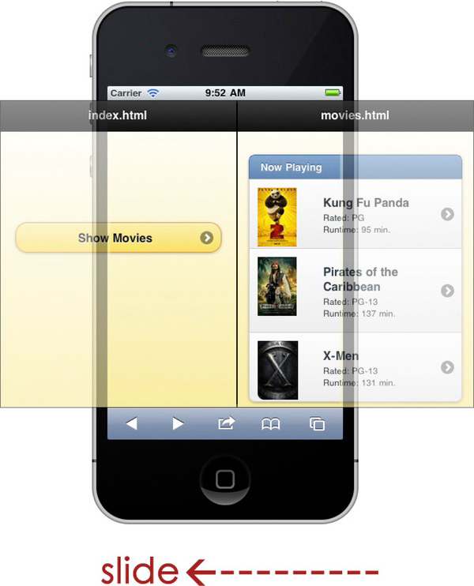
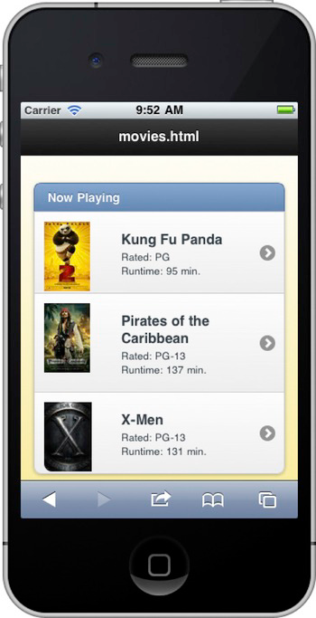

Slide 49
Dialogs
Dialogs are similar to pages except their border is inset to give them the appearance of modal dialog.
You can transform a page into a dialog at either a link or page component.
On the link add the data-rel=“dialog” attribute.
jQuery will automatically load the target page and enhance it as modal dialog.
Dialogs will not appear in history and cannot be bookmarked

Slide 50
Popups
It has similar markup pattern to the dialog widget.
A popup div has to be nested inside the same page as the link.
Framework, currently doesn’t support chaining-of-popups.
Creating a popup:
Create a link to open the popup
<a href="#popupBasic" data-rel="popup">Open Popup</a>
Creating popup div
<div data-role="popup" id="popupBasic">
<p>This is a completely basic popup, no options set.<p>
</div>

Slide 51
API
Configuring Defaults
Events
Methods & Utilities
Data Attributes
Theme Framework

Slide 52
Configuring Defaults
To override default settings, bind to ‘mobileinit’:
$(document).bind("mobileinit", function(){
$.mobile.activePageClass = “page1”;
$.mobile.activeBtnClass = “btn1”;
$.mobile.ajaxEnabled = true;
$.mobile.defaultPageTransition = 'none';
$.mobile.loader.prototype.options.text = “test”
$.mobile.loader.prototype.options.textVisible = true;
$.mobile.loader.prototype.options.theme = “e";
// and so on…
});

Slide 53
Events
jQuery Mobile offers several custom events -
Built upon native events to create useful hooks for development
employs various touch, mouse, and window events, depending on event existence.
Use $(document).bind('pageinit'), not $(document).ready()

Slide 54
Events (Contd…)
Touch Events : tap, taphold, swipe, swipeleft, swiperight
Virtual Mouse Events : vmouseover, vmousedown, vmousemove, vclick
Orientationchange, scrollstart, scrollstop

Slide 55
Events (Contd…)
Page Load : Pagebeforeload, pageload, pageloadfailed
Page Change : Pagebeforechange, Pagechange, Pagechangefailed
Page Transition : pagebeforeshow, pageshow, pagebeforehide, pagehide
Page Initialization : pagebeforecreate, pagecreate, pageinit
Pageremove, updatelayout
Animation Events :
$(document).bind("pagehide", function(event, ui) {
$(ui.nextPage).animationComplete(function() {
alert('Animation completed');
});
});

Slide 56
Methods & Utilities
JQM exposes several methods and properties on the $.mobile object for use in your applications.
Programmatically change from one page to another
$.mobile.changePage()
Other Methods -
$.mobile.loadPage()
$.mobile.loading(‘show’)
$.mobile.silentScroll(yPos)
Other Properties -
$.mobile.activePage()

Slide 57
Data Attributes
JQM framework uses HTML5 ‘data-’ attributes.
Button –
data-mini, data-theme
data-corners, data-icon
Checkbox –
data-mini, data-theme
data-role
Header –
data-theme
data-id, data-position

Slide 58
Theme Framework
JQM’s theming system -
Similar to ThemeRoller in jQUI, with a few important improvements.
Takes advantage of CSS3 properties to add -
Rounded Corners
Box and Text Shadow & Gradients, instead of images
Lightweight theme file
Reduces server requests
Themes include –
Multiple color ‘swatches’
Open-ended theming allows for up to 26 unique swatches per theme
‘Simplified icon set’ in a sprite to reduce image weight.
Overriding of themes

Slide 59
Queries?

Slide 60
Thank You
Ref : http://jquerymobile.com/demos/1.2.0/
Email :

